Slide 1





Module 04- Functions and modules
WWW.SELACLOUD.COM

Slide 2

Agenda
What is Function?
Function Definition
Function Arguments
Local and Global Variables
Pass by reference vs value
Modules in Python
Import Statement
The from .. Import statement
Locating Modules
Packages intro
Useful built-in statements

Slide 3
What is a Function?
Function is a small sub program that perform a single task
Functions provide better modularity and high code reuse
Python has many build-in functions but user can define his own function
Function definition starts with def keyword, function name and then list of parameters in () parentheses, : at the end
Functions in python can use return statement.
return can come with expression, the one that we want to return
return can be empty
return exits the function.
Notes:
Python is dynamically-typed and garbage-collected. It supports multiple programming paradigms, including structured (particularly, procedural), object-oriented and functional programming.
It was built to be as readable as possible, and is significant indentation driven (Off-side rule).
The language's core philosophy is summarized in the document The Zen of Python (PEP 20), which includes aphorisms such as:
Beautiful is better than ugly.
Explicit is better than implicit.
Simple is better than complex.
Complex is better than complicated.
Readability counts.
For further reading:
Python (programming language) - Wikipedia

Slide 4
Functions documentation strings
First function statement can be the function documentation called docstring.
Python documentation string is used like a comment and provide a convenient way to access this documentation even in run time
Python docstrings can be placed in functions, classes, modules
In python docstring can be accessed with help function or obj.__doc__
help(my_func) # prints my_func function docstring s = my_func.__doc__ # returns prints my_func function docstring
Notes:
Python is dynamically-typed and garbage-collected. It supports multiple programming paradigms, including structured (particularly, procedural), object-oriented and functional programming.
It was built to be as readable as possible, and is significant indentation driven (Off-side rule).
The language's core philosophy is summarized in the document The Zen of Python (PEP 20), which includes aphorisms such as:
Beautiful is better than ugly.
Explicit is better than implicit.
Simple is better than complex.
Complex is better than complicated.
Readability counts.
For further reading:
Python (programming language) - Wikipedia

Slide 5
Function Definition
def func_name(parameters):
"docstring"
command
.
.
command
[return expr]
For example:
def simple_print(str): "function prints value of parameter" print("parameter is:", str) simple_print("Python functions are great!!")
docstring
Function call

Slide 6
Function overloading
Python does not support function overloading
When function with the same name defined more than once, they are treated as function redefinition and last one wins
Python has many different ways to overcome this obstacle, like default arguments, variable-length parameters, etc (will be discussed later)

Slide 7
Function Arguments
Required arguments:
Required arguments must be passed to a function in correct order and exact amount.
For example:
def print_data(color, size): print ("color: ", color, " and size : ", size) print_data("Red", 4) # prints color: Red and size : 4 print_data("Blue") #generates arguments count error
Notes:
PyCharm is currently one of the most used IDE for python development, It provides code analysis, a graphical debugger, an integrated unit tester, integration with version control systems (VCSes), and supports web development with Django as well as data science with Anaconda.
It was created by JetBrains
It is mostly popular because of many things, such as:
It is considered as an intelligent code editor, fast and safe refactoring, and smart code.
Features for debugging, profiling, remote development, testing the code, auto code completion, quick fixing, error detection and tools of the database.
Support for Popular web technologies, web frameworks, scientific libraries and version control.

Slide 8
Function Arguments – cont’d
Keyword arguments:
Arguments can be pass by keyword (name). We can pass arguments in any order when passing them by names.
Non-keyword arguments are allowed after keyword ones
Example 1:
Example 2:
def print_data(size, color): print("color:", color, "and size:", size) print_data(size=6, color="Blue") print_data(color="Blue", size=6)
def func(x=1,y=2): print(x,y) func(2,6) #prints 2,6 func(2) #prints 2,2 func(x=2,6) # generates the error

Slide 9
Function Arguments – cont’d
Default Arguments:
A default argument is an argument that defines a default value. The argument holds this default value, unless other value is passed
If function have both default and formal arguments, formal arguments must be defined first.
def print_data(color, size=10): print("color: ", color, " and size : ", size) print_data("Yellow") # color: Yellow and size : 10 print_data(size = 3, color="Yellow") #color: Yellow and size : 3

Slide 10
Function Arguments – cont’d
Variable-Length parameters:
The special syntax, *args and **kwargs in function definitions is used to pass a variable number of arguments to a function.
The single asterisk form (*args) is used to pass a non-keyworded, argument list, that passed as tuple
The double asterisk form (**kwargs) is used to pass a keyworded, variable-length argument list, that passed as name-value dictionary

Slide 11
Function Arguments – cont’d
Variable-Length *args example:
def calc_aver(*args): sm = 0 for elem in args: sm += elem return float(sm) / len(args) aver = calc_aver(1, 2, 3, 4); print(aver) # prints 2.5 aver = calc_aver(1, 2, 3, 4, 52); print(aver) # prints 12.4

Slide 12
Function Arguments – cont’d
Variable-Length **kwargs example:
title: all values
1) y=abc
2) x=1
3) z=-3.5
def print_named_variables(title, **dict): print ("title: ", title) cnt = 1 for var_name,var_value in dict.items(): print ("{}) {}={}" .format(cnt, var_name, var_value)) cnt+=1 print_named_variables("all values", x=1,y="abc",z=-3.5)

Slide 13
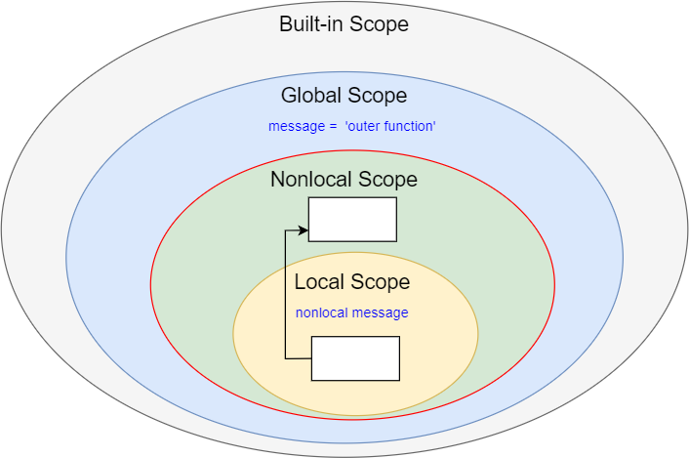
Local and Global Variables
The scope of a variable determines where it can be accessed.
Variables that are defined inside a function body have a local scope. Local variables can be accessed only inside the function in which they are declared
Variables that are defined outside any function have a global scope. Global variables can be accessed throughout the program body by all functions.

Slide 14
Local and Global Variables – cont’d
def f(): s = "I am globally unknown" # define local variable s print(s) # prints "I am globally not known“ f() print(s) # generates error

Slide 15
Local and Global Variables – cont’t
Example 1:
The Output:
in func: 10
in main space : 10
Example 2:
The Output:
in func: 11
in main space : 10 – Why??
def func(): print("in func: ", glob) glob = 10 func() print("in main space: ", glob)
glob = 10 def func(): glob = 11 print("in func: ", glob) func() print("in main space: ", glob)

Slide 16
Local and Global Variables – cont’d
Lets add one new line code to the func function from the previos example:
What will be the output now?
Python "assumes" that we want a local variable due to the assignment to glob inside of func(), so the first print statement throws this error message.
glob = 10 def func(): print("in func: ", glob) glob = 11 print("in func: ", glob) func() print("in main space: ", glob)

Slide 17
Local and Global Variables – cont’d
Any variable which is changed or created inside of a function is local unless it hasn't been declared as a global variable.
glob = 10 def func(): global glob print("in func: ", glob) glob = 11 print("in func: ", glob) func() print("in main space: ", glob)

Slide 18
Pass by reference vs value
All parameters in the Python language are passed by assignment.
If we change what a parameter refers to within a function, the change also reflects back in the calling function. For example:
The Output:
inside the function: [1, 2, 3, 4]
outside the function: [1, 2, 3, 4]
def chang_list( lst ): "This changes a passed list into this function" lst.append(4) print ("inside the function: ", lst) list = [1,2,3] chang_list(list ) print ("outside the function: ", list)

Slide 19
Pass by reference vs value – cont’d
The Output:
inside the function: [4]
outside the function: [1, 2, 3]
def chang_list( lst ): "This changes a passed list into this function" lst = [4] print ("inside the function: ", lst ) list = [1,2,3] chang_list(list ) print ("outside the function: ", list)

Slide 20
Pass by reference vs value – cont’d
The Output:
inside the function: is fun
outside the function: python
def chang_string( s ): s = "is fun" print ("inside the function: ", s) s = "python" chang_string(s) print ("outside the function: ", s)

Slide 21
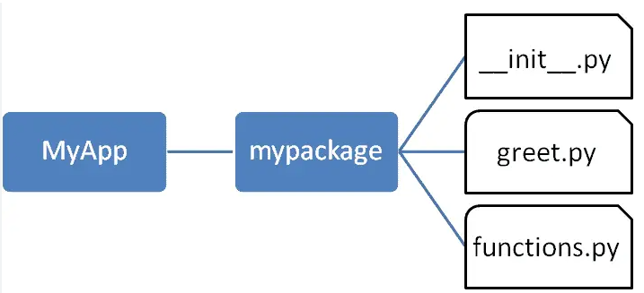
Modules in Python
As your program gets longer, you may want to split it into several source files for easier maintenance
File that contains definitions only can be treated as module and can be used in python programs.
Module can define functions, classes and global variables
Definitions from a module can be imported into python program and other modules

Slide 22
Import Statement
import module_name imports all the module_name’s definitions under namespace
import my_module
The default namespace name is module name.
Namespace name can be changed with as statement in import line
import my_module as MM
All module’s definitions can be accessed through namespace only
my_module.my_func(…)

Slide 23
Import Statement - example
Lets say we have utils.py file with 2 function:
def do_somthing1():
….
def do_somthing2():
….
import utils
utils.do_somthing1()

Slide 24
The from...import Statement
Python's from statement lets you import specific attributes or all attributes from a module into the current namespace.
The from...import has the following syntax: from module_name import name1, name2, ... nameN
from utils import do_something1
from utils import *
Namespaces are omitted using from...import add only direct access is possible
do_something1()
utils.do_something1() #generates error

Slide 25
Init file
The __init__.py file, commonly referred to as the "init file," is a special file in a Python package that serves as an initializer for the package. It is executed when the package is imported, allowing you to perform necessary setup and define the contents of the package.
In addition to its role as an initializer, the init file can also transform a directory into a Python package. Without an init file, the directory would simply be treated as a regular folder without any package-specific functionality.

Slide 26
Init file – cont’d
Imports: You can import other modules or packages that are part of the package. This allows you to organize your code into separate modules and use them within the package.
Variable and Constant Definitions: You can initialize variables, constants, or any other objects that will be used by the package. These definitions can be accessed by other modules within the package.
Function Definitions: You can define functions that are specific to the package or provide utility functions that can be used throughout the package.
Initialization Code: You can include any necessary initialization code that needs to be executed when the package is imported. This can involve setting up configurations, connecting to databases, or performing any other required setup tasks.
Overall, the init file plays a vital role in structuring and initializing a Python package. It allows you to organize code, define package-level variables and functions, and perform necessary setup operations when the package is imported.

Slide 27
Init file

Slide 28
Init file – demo
Let's consider a package named greetings, which provides simple greeting functions. We can create the following directory structure:
greetings/
__init__.py
english.py
spanish.py
__init__.py
english.py
spanish.py
from .english import say_hello as hello_english from .spanish import say_hello as hello_spanish
def say_hello(): print("Hello!")
Output:
import greetings greetings.hello_english() # Output: Hello! greetings.hello_spanish() # Output: ¡Hola!
def say_hello(): print("¡Hola!")

Slide 29
Locating Modules
When importing modules the interpreter searches:
First interpreter searches in the current directory.
If the module isn't found, Python then searches each directory in the shell variable PYTHONPATH
If the module isn’t found, the interpreter searched in standard installation path. (In Linux/Unix for example in /usr/local/lib/python)
If the module is not found in any of the above locations, the interpreter raises an “ImportError” indicating that the module could not be found.

Slide 30
Python packages
To help organize modules and provide a naming hierarchy, python has a concept of packages
The __init__.py files are required to make Python treat the directories as package
Access to modules inside a package through the full name: package_name.module_name
Packages can contains sub-packages

Slide 31
Lab 01-08

